Slide 1

Port Forwarding Risks When Self Hosting
by Sam Hanna
Scale22x

Slide 2

Who am I
My name is Sam Hanna.
I have been a Linux user for over 15 years and a self taught individual in self hosting that spans for over 10 years.
This is my second appearance as a speaker at Scale.
I am an advocate of open source software and self-hosting.
My goal is to reach out and spread my knowledge to others and hope to inspire others just as the open source community has done for him.
Scale22x

Slide 3
Table of Contents
What is Port Forwarding and why we Port Forward
Risks of Port Forwarding
Ways To Port Forward Securely
Access devices without Port Forwarding
Scale22x

Slide 4
What Is Port Forwarding
Port Forwarding is a network configuration that allows external devices to access specific services on a private network by directing incoming internet traffic to a designated port on a specific device within that network.
Common ports that are usually forwarded are port 80 for web traffic (HTTP), port 22 for SSH access, port 25 for email (SMTP) if allowed, port 443 for secure web traffic (HTTPS), port 53 for DNS.
There are 65,535 possible port numbers. The first 1023 are pre-assigned (aka Known ports) and cannot be changed. The rest can be assigned based on the parameters of the application in use.
Most routers have this feature available.
If you use a wireless internet provider like T-Mobile Home Internet or Starlink, then this feature is not available and will need to use a VPN setup to provide access to your devices (uses IPV6 and does not port forward). Will discuss later in the session.
Scale22x

Slide 5
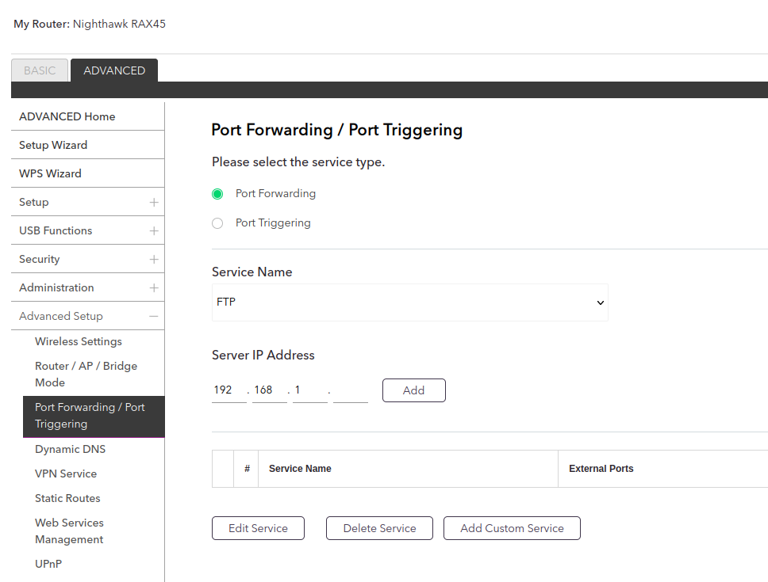
How To Port Forward
If your ISP allows it, Port forwarding is usually located in the advanced settings in your router. Enter the IP address of the device and the port number you would like .
Scale22x

Slide 6
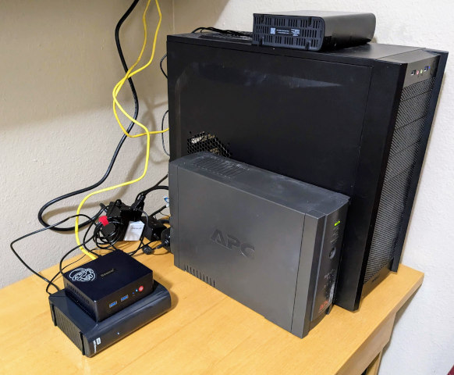
Why We Port Forward
The primary reason for port forwarding is to enable remote access to devices on your network, allowing you to control them from anywhere with an internet connection.
By specifying a port number, you can direct incoming traffic to a specific device on your network, rather than having it go to your router generally.
While necessary for certain applications, port forwarding can also be a security concern as it opens up your network to potential unauthorized access, so it's important to only forward ports for trusted services and to use strong security practices.
Scale22x

Slide 7

What Are The Risks
Scale22x

Slide 8
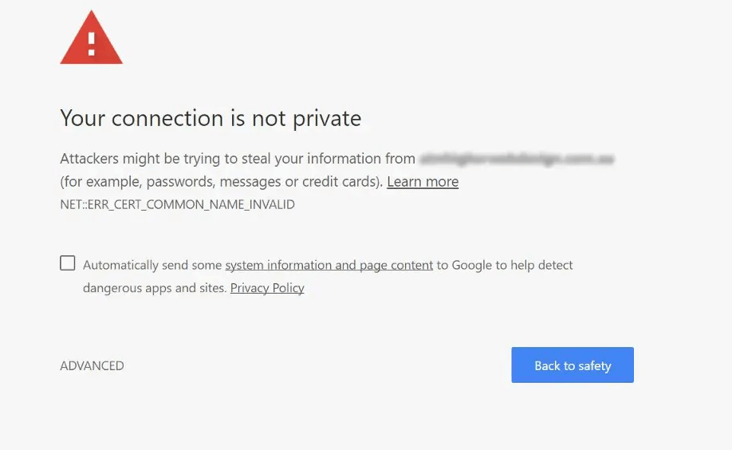
What Are The Risks
Everything in clear text – without taking measures like encryption or authentication, everything is visible in clear text.
Scale22x

Slide 9
What Are The Risks
Everything in clear text – without taking measures like encryption or authentication, everything is visible in clear text.
Unauthorized Access to Devices - Anyone with knowledge of the open port could potentially access the device connected to it, allowing them to control or extract data from that device.
Scale22x

Slide 10
What Are The Risks
Everything in clear text – without taking measures like encryption or authentication, everything is visible in clear text.
Unauthorized Access to Devices - Anyone with knowledge of the open port could potentially access the device connected to it, allowing them to control or extract data from that device.
Potential for Malware Infection - inject malware onto your network, particularly if the application associated with the forwarded port has known vulnerabilities.
Scale22x

Slide 11
What Are The Risks
Everything in clear text – without taking measures like encryption or authentication, everything is visible in clear text.
Unauthorized Access to Devices - Anyone with knowledge of the open port could potentially access the device connected to it, allowing them to control or extract data from that device.
Potential for Malware Infection - inject malware onto your network, particularly if the application associated with the forwarded port has known vulnerabilities.
Vulnerability to Brute-Force Attacks - Hackers can use automated tools to attempt numerous password combinations against a forwarded port, especially if the service is not protected with strong authentication mechanisms.
Scale22x

Slide 12
What Are The Risks
Everything in clear text – without taking measures like encryption or authentication, everything is visible in clear text.
Unauthorized Access to Devices - Anyone with knowledge of the open port could potentially access the device connected to it, allowing them to control or extract data from that device.
Potential for Malware Infection - inject malware onto your network, particularly if the application associated with the forwarded port has known vulnerabilities.
Vulnerability to Brute-Force Attacks - Hackers can use automated tools to attempt numerous password combinations against a forwarded port, especially if the service is not protected with strong authentication mechanisms.
Exposure of Sensitive Data - If a service running on a forwarded port handles sensitive information, such as login credentials or financial details, leaving the port open could expose this data to unauthorized access.
Scale22x

Slide 13

Port Forward Securely
Scale22x

Slide 14
Port Forward Securely
Restrict access by IP address - When setting up a port forwarding rule, specify the exact IP address of the device you want to access, preventing unauthorized connections from other devices on the internet.
Scale22x

Slide 15
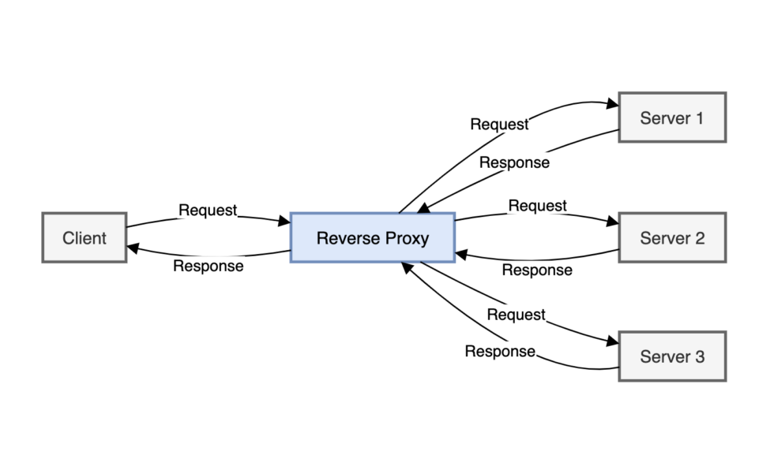
Port Forward Securely
Restrict access by IP address - When setting up a port forwarding rule, specify the exact IP address of the device you want to access, preventing unauthorized connections from other devices on the internet.
Only forward essential ports - Do not open unnecessary ports; only forward the ports required for the specific application or service you want to access.
              maybe using a reverse proxy to route to other application with exposing them to the internet.
              A reverse proxy is a server or application that directs the domain name to the correct IP address and port number of the application. Only requires port 80 and 443 to be exposed.
Scale22x

Slide 16
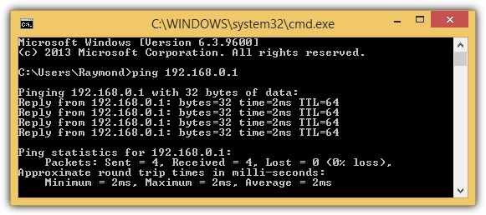
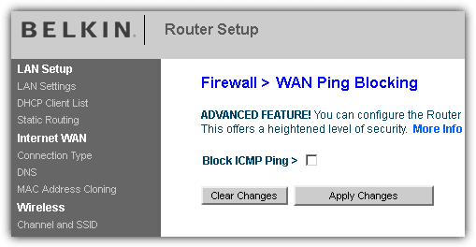
Port Forward Securely
Restrict access by IP address - When setting up a port forwarding rule, specify the exact IP address of the device you want to access, preventing unauthorized connections from other devices on the internet.
Only forward essential ports - Do not open unnecessary ports; only forward the ports required for the specific application or service you want to access.
Utilize a robust firewall - Ensure your router's firewall is properly configured to block unwanted traffic and only allow connections to the forwarded ports.
- I.E, blocking ping requests
Scale22x

Slide 17
Port Forward Securely
Restrict access by IP address - When setting up a port forwarding rule, specify the exact IP address of the device you want to access, preventing unauthorized connections from other devices on the internet.
Only forward essential ports - Do not open unnecessary ports; only forward the ports required for the specific application or service you want to access.
Utilize a robust firewall - Ensure your router's firewall is properly configured to block unwanted traffic and only allow connections to the forwarded ports
Monitor port activity - Regularly check for suspicious activity on the forwarded ports using network monitoring tools to detect potential security breaches.
      Zabbix – link to site for more information.
Scale22x

Slide 18
Port Forward Securely
Restrict access by IP address - When setting up a port forwarding rule, specify the exact IP address of the device you want to access, preventing unauthorized connections from other devices on the internet.
Only forward essential ports - Do not open unnecessary ports; only forward the ports required for the specific application or service you want to access.
Utilize a robust firewall - Ensure your router's firewall is properly configured to block unwanted traffic and only allow connections to the forwarded ports
Monitor port activity - Regularly check for suspicious activity on the forwarded ports using network monitoring tools to detect potential security breaches.
Consider a VPN or secure remote access service - For added security, particularly when accessing forwarded devices remotely, setup a VPN or a secure remote access solution that encrypts data transmission(I.E. Tailscale)
Scale22x

Slide 19


3 Ways To Setup A VPN
Scale22x

Slide 20
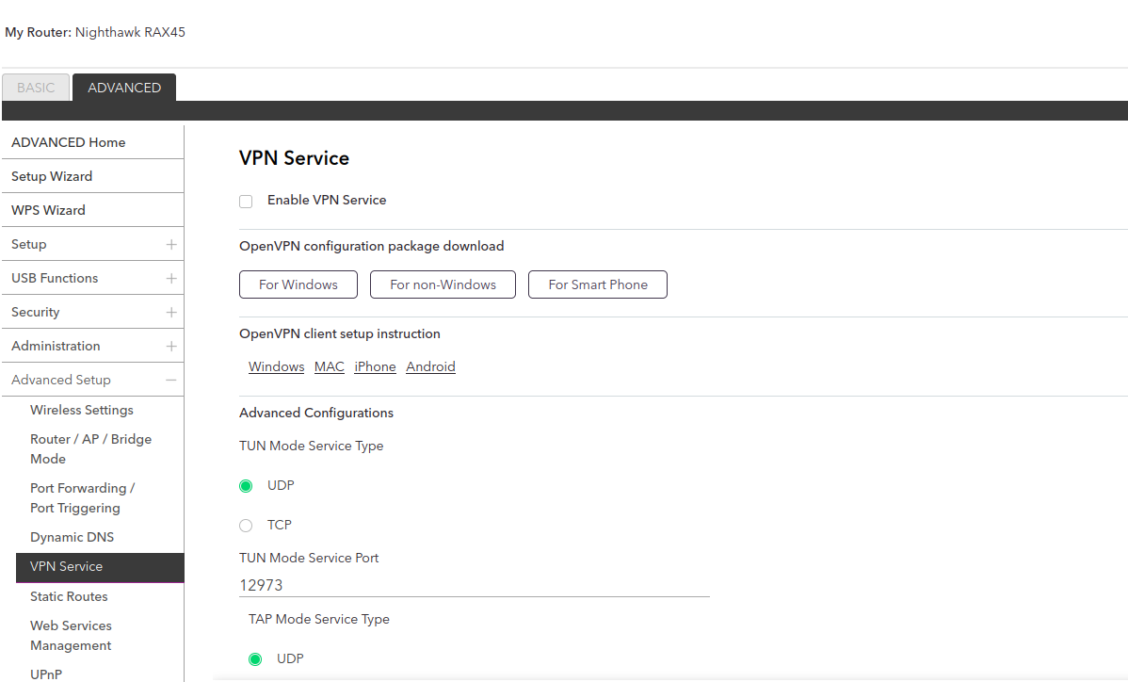
3 Ways To Setup A VPN
Check to see if your router supports VPN access. there would be a setting that can allow users to connect to their network with a pre-configured openvpn profile that can be imported to a phone or PC.
Scale22x

Slide 21
3 Ways To Setup A VPN
Check to see if your router supports VPN access. there would be a setting that can allow users to connect to their network with a pre-configured openvpn profile that can be imported to a phone or PC.
You can create your own VPN access by choosing a VPN software like OpenVPN or WireGuard and installing it on a local machine, allowing you to customize your security settings and access your network remotely; however, this method requires more technical knowledge (VPN’s like Private Internet Access are not a solution for this)
      VPN’s like private internet access or NordVPN are good for preventing man in the middle attacks or hiding traffic from your ISP.
      You want to have a one to one connection with the client and the remote device that you want to have a encrypted connection.
Scale22x

Slide 22
3 Ways To Setup A VPN
Check to see if your router supports VPN access. there would be a setting that can allow users to connect to their network with a pre-configured openvpn profile that can be imported to a phone or PC.
You can create your own VPN access by choosing a VPN software like OpenVPN or WireGuard and installing it on a local machine, allowing you to customize your security settings and access your network remotely; however, this method requires more technical knowledge (VPN’s like Private Internet Access are not a solution for this).
If you want a super easy way to get started with setting up a VPN, you can use a third party solution like Tailscale. They have a very easy simple installation on Windows, Mac, Linux, Android, and IOS. They both have a simple interface and port forwarding is not needed. Will be discussed in detail later in the slides.
Scale22x

Slide 23
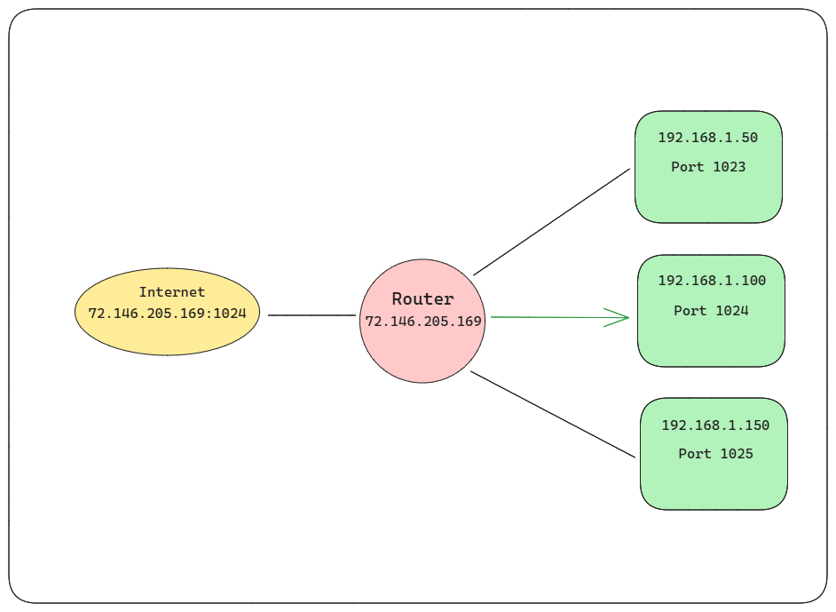
Diagram of VPN Setup
Scale22x

Slide 24
Access Devices Without Port Forwarding
Here are ways to get access to your devices without port forwarding. This is also works for people who use a ISP router that don’t allow port forwarding, also known as Carrier-grade NAT. this can be great if want to setup a domain and don’t want to port forward port 80 and 443. This removes the need for a reverse proxy.
Tailscale ( Free up to 100 devices)
Cloudflare Tunnel (Free for all users, domain name access only)
Create your own tunnel (domain name access only)
Scale22x

Slide 25
Cloudflare Tunneling
When using a Cloudflare Tunnel, you can access your server through a custom domain name, and while your server might have a private IP address, the traffic is routed through Cloudflare's network, meaning the public IP address seen by the outside world will be a Cloudflare IP address, not your server's actual IP address; essentially, Cloudflare Tunnel hides your server's public IP address by acting as a proxy.
Cloudflare Tunnel can connect HTTP web servers, SSH servers, remote desktops, and other protocols safely to Cloudflare.
This way, your origins can serve traffic through Cloudflare without being vulnerable to attacks that bypass Cloudflare.
No reverse proxy is needed.
Downside to Cloudflare tunnel is streaming is not allowed and that the bandwidth can be throttled for video. Not recommended for media servers.
Link to video on how to setup Cloudflare tunnel
Scale22x

Slide 26
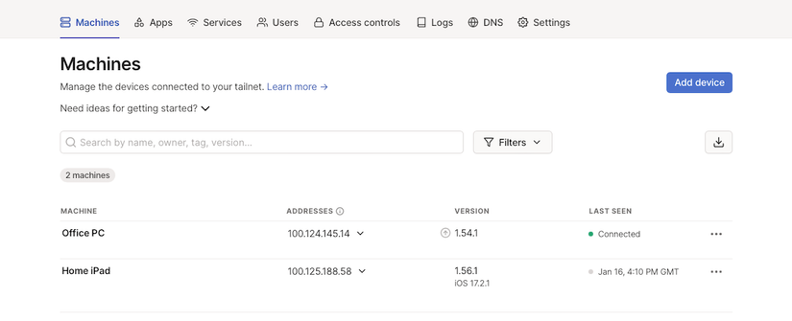
Tailscale
Tailscale is a virtual private network (VPN) that lets you securely connect devices and services across networks.
It uses the open-source WireGuard protocol to create encrypted connections.
Makes creating software-defined networks easy: securely connecting users, services, and device. Here is a link to a video on how to setup Tailscale
Scale22x

Slide 27
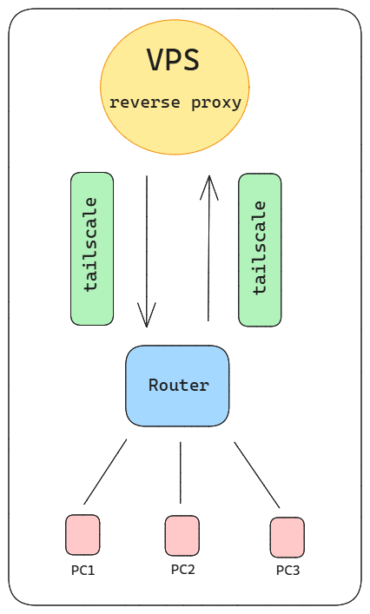
Creating your own Tunnel
This is great way to set up domain to access your server without port forwarding.
This can used to bypass restriction of throttling bandwidth
This can be used with tailscale or Zerotier. As long as VPN or your choice is installed on both, the VPS and the pc you want to connect to.
You can set up any VPS such as Linode, Digital Ocean, or Oracle Cloud.
Link below to see a video tutorial on how to set this up.
Link to a video on creating your own Cloudflare tunnel
Scale22x

Slide 28
Now You Are A Port Forward Wizard!
Have any questions or want a copy of the slides, you can reach me at:
X/Twitter: @SamHanna84
Email: sam.hanna@homelabwithsam.site
Scale22x

